Slide 1

Home Alone
Scheduling solution for home-alone child utilizing AI/ML

Slide 2




MOTIVATION
declination of birth rate
dual income family growth
child care has been major issue.

Slide 3
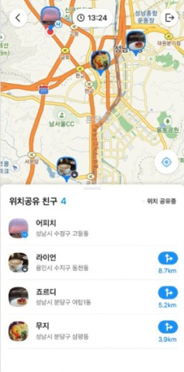
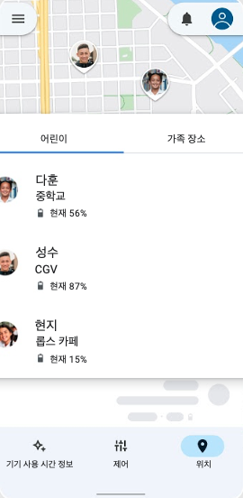

PROBLEM STATEMENT
Keeping track of the child`s
location at home is unavailable
Schedule control cannot be
done by parents 100%

Slide 4



Requirements& Specification
Login
used for identification
pressing the button → page will connect to Google Account
Main page
showing kid`s current status
showing kid`s current schedule
- the time remaining until the most immediate schedule
- place where schedule is taken
- the starting time of the next event
Schedule managing page
Schedule add button
- add schedule (containing values of title, timestamp, location )
Schedule table
- modify (modify pop-up button )
- delete button (clicking the delete button → pop-up message )

Slide 5


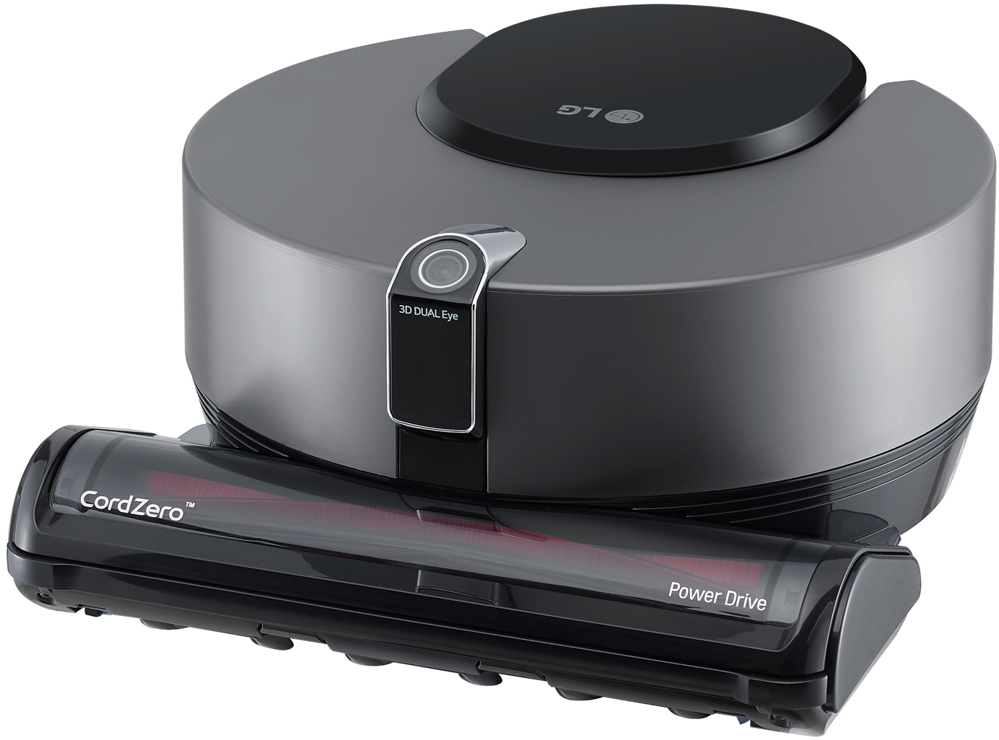
Requirements& Specification
Detect Child’s pose
service detects child`s current pose in three states:
laying, sitting, standing
Location detector
find location in the house whether kid is in the house or not
- cannot pinpoint its direct location but sort of info
LG vacuum cleaner
5 photos, detecting state(whether he is sleeping
face detectopn, precise dection for the object really he is the kid

Slide 6

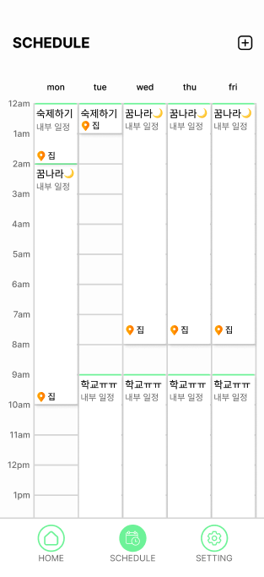
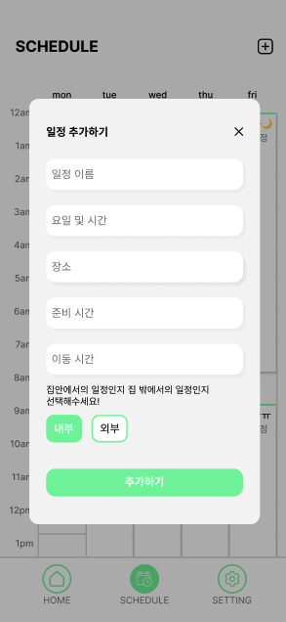
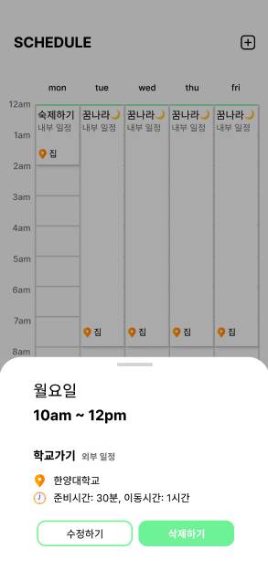
PROGRESS ( Front end )
Login with google
show schedule table from database

Slide 7
PROGRESS ( Back end )
Naver
API
App
API
Web client
for test
Station
Server
AI algo

Slide 8
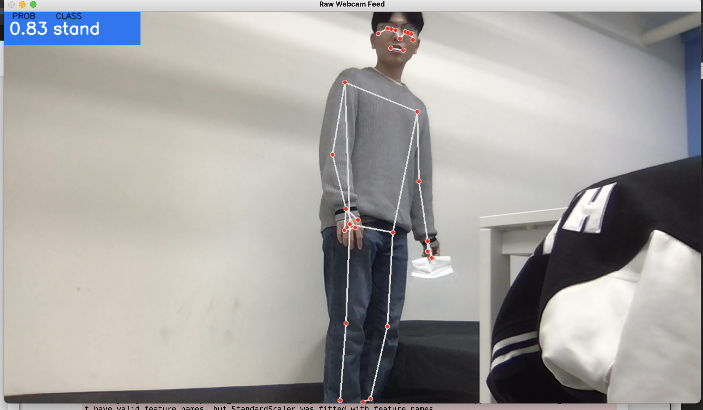
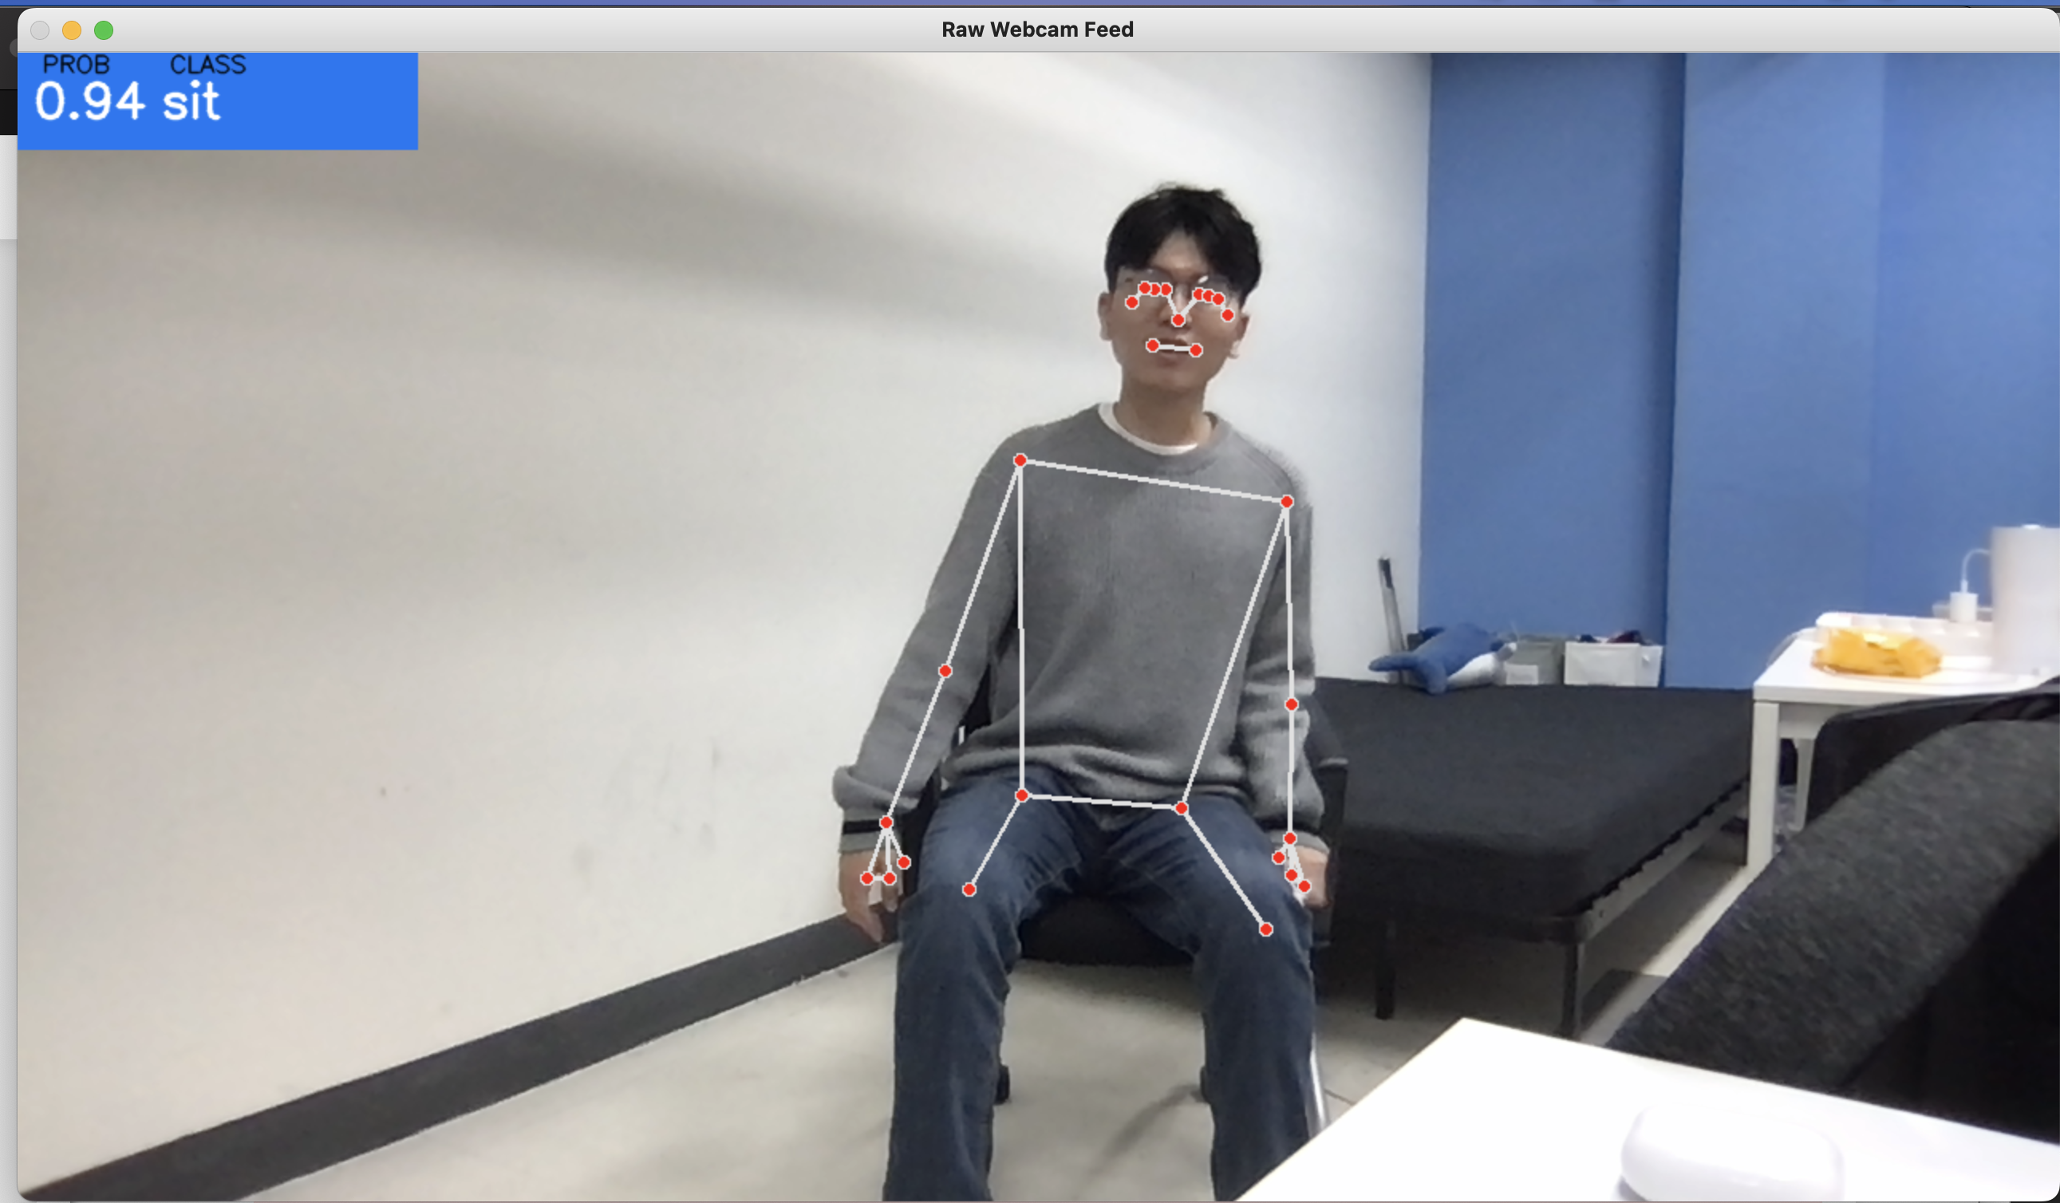
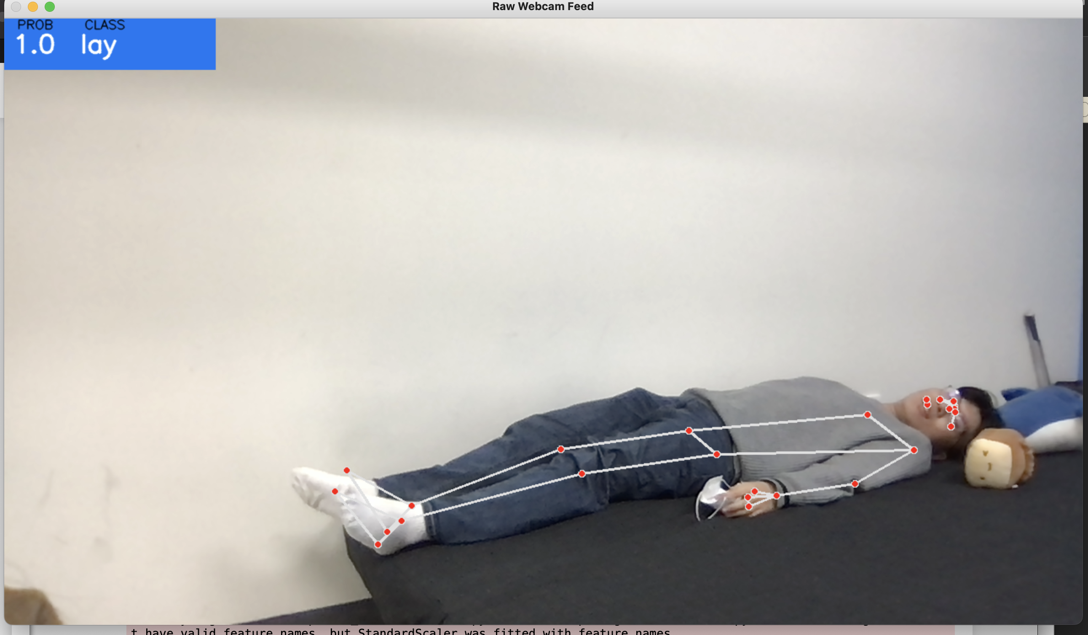
PROGRESS ( AI )

Slide 9
NEXT PLAN
11 / 18
11 / 25
12 / 02
Front end
Back end
Communicate with API server, last logic completed
Development of AI Speaker SDK
Back end
Document
Completion of the other module,
communication between station server and API server
create document in latex
Blog update
AI
Presentation
Complete FACE DETECTION
Directionalizing for Demo Day

